Slide 1
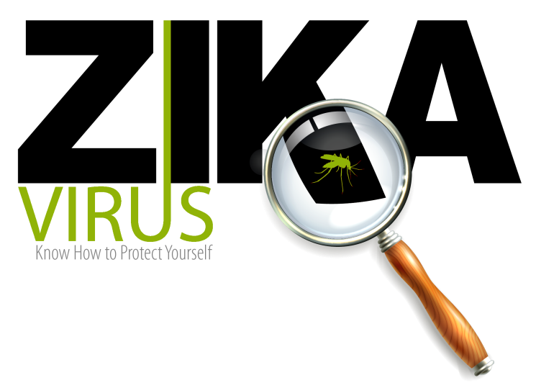
Presenter Information
….

Slide 2
^{BLUF}
BOTTOM LINE:
No vaccine exists to prevent Zika
If you live in or travel to an area with ongoing Zika virus transmission, take precautions to minimize risk.
The risk of Zika infection is reduced by taking measures to avoid mosquito bites and sexual contact with men who have been infected with Zika.
Pregnant women or women trying to become pregnant should avoid travel to areas with active Zika virus transmission.
Notes:
Anyone who lives in or travels to an area where Zika virus is found and has not already been infected with Zika virus can get it from mosquito bites. Once a person has been infected, he or she is likely to be protected from future infections.
Most people infected with the Zika virus will present mild symptoms, if any at all.
However if you are pregnant or may become pregnant you should take measures to reduce your risk of infection by avoiding mosquito bites and sexual contact with men who have been exposed.

Slide 3
^{Agenda}
What is Zika virus?
How is Zika spread?
Where is it found?
What are the symptoms?
What can you do to protect yourself?
What about pregnant women?
Summary

Slide 4
^{What is Zika virus?}
Zika virus is one of several infections spread by the Aedes mosquito, which also spreads dengue and chikungunya.
Usually a mild illness.
However, Zika can cause birth defects and has been linked to neurologic disorders.
Notes:
Zika is one of several infections spread by the Aedes mosquito, which also spreads dengue and chikungunya.
The illness is usually mild with symptoms lasting for several days to a week after being bitten by an infected mosquito. People usually don’t get sick enough to go to the hospital, and they very rarely die of Zika.
Zika virus infection during pregnancy can cause a serious birth defect called microcephaly, as well as other severe fetal brain defects. Microcephaly is a condition where a baby is born with an abnormally small head and incomplete brain development.
Zika infection may cause Guillain-Barré syndrome, a rare disorder in which your body's immune system attacks the nerves, leading to nerve damage or paralysis that lasts for several weeks or several months. Most people fully recover, but may take a few months or longer.
Due to the potential connection with birth defects, women who are pregnant or trying to become pregnant should avoid travel to areas where Zika transmission is ongoing or talk to their healthcare provider before traveling if travel cannot be avoided.

Slide 5
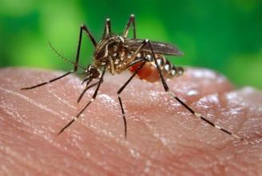
^{How is Zika spread?}
Mainly through mosquito bites.
Less commonly:
Mother to child during pregnancy.
Infected man to his sex partners.
Possibly blood transfusions.
The FDA has instituted precautions to protect the US blood supply.
Aedes aegypti Photo: CDC
Notes:
Zika virus (Zika) is spread to people primarily through mosquito bites.
People primarily become infected with Zika virus through the bite of an infected mosquito. Zika virus can be found in the blood of an infected person and can be passed from an infected person to a mosquito through mosquito bites. An infected mosquito can then spread the virus to other people.
Zika can spread from mother to child during pregnancy. Zika is a cause of microcephaly and other severe fetal brain defects, and we are studying the full range of other potential health problems that Zika virus infection during pregnancy may cause.
- A pregnant woman already infected with Zika virus near the time of delivery can pass on the virus to her newborn around the time of birth.
- To date, there are no reports of infants getting Zika virus through breastfeeding. Because of the benefits of breastfeeding, mothers are encouraged to breastfeed even in areas where Zika virus is found.
An infected man can spread the virus to his sex partners (male or female). At this time, however, there is no evidence that women can transmit the Zika virus to their sex partners.
Blood transfusions may be another possible source. Anyone who has traveled to an area with Zika transmission is asked to defer donating blood for 28 days. The FDA has instituted precautions at blood collection centers to protect the US blood supply.

Slide 6
^{Where is it found?}
The current Zika virus transmission area includes much of South and Central America and the Caribbean.
The virus is expected to spread to nearly all countries in the Americas.
Notes:
First identified in Africa in 1947, Zika virus has been known to be present in parts of Africa, Asia, and the Pacific for decades.
Most recently, Zika has been rapidly spreading in South and Central America and the Caribbean.
The virus is expected to spread to some parts of nearly all countries in the Americas including the United States. Local Zika transmission has been identified in Puerto Rico, the US Virgin Islands, and American Samoa.
Only imported cases of Zika have been identified in the continental United States—that is, cases among travellers returning from areas with active Zika transmission. Zika outbreaks in the U.S. mainland, if they occur, are likely to be relatively small and localized due to protective factors like window screens and less dense living conditions.
Zika virus will continue to spread and it will be difficult to determine how and where the virus will spread over time.
For the most current travel alerts visit: http://www.cdc.gov/zika/geo/active-countries.html

Slide 7
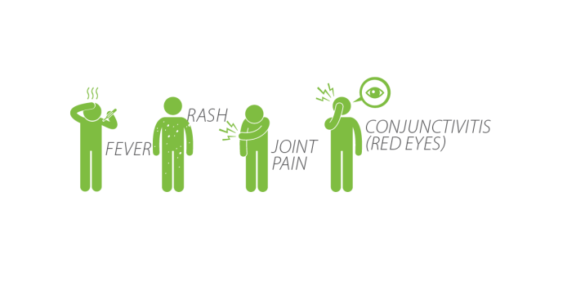
^{What are the symptoms?}
About 1 in 5 people infected with Zika becomes ill.
The illness is usually mild and symptoms last from several days to a week.
Notes:
Most people infected with Zika virus won’t even know they have the disease because they won’t have symptoms. The illness is usually mild and includes fever, rash, joint pain, or red eyes. Symptoms last from several days to a week.
If you or someone you know develops any of these symptoms, especially within two weeks of traveling to an area with ongoing Zika transmission, see your healthcare provider. This is especially important if you are pregnant or are trying to become pregnant. Report your travel history so they can coordinate appropriate testing and advise on care. Other mosquito-borne diseases, such as dengue and chikungunya, are also present in many of the same areas with Zika virus and have similar symptoms.
No vaccine or specific treatments are available to prevent or treat Zika. In general, symptoms can be treated with acetaminophen; be sure to rest and to stay hydrated. Avoid taking aspirin and other non-steroidal anti-inflammatory drugs (NSAIDs) until dengue infection is ruled-out, as these medications may increase the risk of bleeding. Consult with your healthcare provider if you are already taking other medications.
All travelers returning from an area with Zika should prevent mosquito bites for three weeks. During this time, Zika virus can be found in the blood and passed from an infected person to a mosquito through mosquito bites. An infected mosquito can then spread the virus to other people.
Zika infection has been linked to a rare condition called Guillain-Barré syndrome. Symptoms of Guillain-Barré syndrome include weakness of the arms and legs that is usually the same on both sides of the body. Seek medical care immediately if you have any concerning symptoms.

Slide 8
What can you do to protect yourself?
The best way to prevent Zika is to prevent mosquito bites. No vaccine or specific treatments are available to prevent or treat Zika.
Minimize time outside when mosquitos are active.
The mosquitoes that spread Zika bite mostly during the daytime
Control mosquitoes around the home by eliminating standing water where mosquitoes breed.
Empty water from containers such as garbage cans, wading pools, and flower pots.
Wear long-sleeved shirts and long pants.
Stay in places with air conditioning or use screens that keep mosquitoes outside.
Use DEET or picaridin insect repellent on exposed skin.
Treat clothing and gear with permethrin or buy permethrin-treated items.
Notes:
No vaccine exists to prevent Zika virus disease (Zika).
Strictly follow mosquito bite prevention methods in areas where there is active Zika virus transmission.
Mosquitoes that spread Zika virus bite mostly during the daytime.
Follow product label instructions when applying insect repellent. When used as directed, these insect repellents are proven safe and effective even for pregnant and breastfeeding women.
Talk to your sexual partners about their potential exposure to Zika and any history of Zika-like symptoms. Consider abstaining from sex or using condoms correctly every time to prevent sexual transmission of Zika virus.
Women who are pregnant or trying to get pregnant who do not live in areas with active transmission of Zika should avoid travel to areas where Zika transmission is ongoing.

Slide 9
What can you do to protect yourself?
Zika virus can spread during sex by a man infected with Zika to his sex partners. It may be possible for a man to carry Zika and give it to his partner(s) through sex, even when he does not have symptoms, or know that he is infected.
Couples that include a man who has been diagnosed with Zika or had symptoms of Zika should consider using condoms or not having sex for at least 6 months after symptoms begin. This includes men who live in and men who traveled to areas with Zika.
Couples that include a man who traveled to an area with Zika but did not develop symptoms of Zika should consider using condoms or not having sex for at least 8 weeks after their return.
Couples that include a man who lives in an area with Zika but has not developed symptoms of Zika should consider using condoms or not having sex while there is Zika in the area.
Notes:
Couples considering this decision should weigh the personal risks and benefits. A man’s risk of having Zika will depend on the length of time he spent in areas with Zika and whether he took steps to prevent mosquito bites while there. Other considerations include:
The mild nature of the illness for most people
The couple’s plans for pregnancy.
The couple’s access to condoms and other contraception;
The couple’s desire for intimacy, including willingness to use condoms or not have sex; and
The couple’s ability to use condoms or not have sex.
Couples who do not want to get pregnant should use the most effective birth control methods that can be used correctly and consistently, in addition to condoms. Talk to your healthcare provider about what steps you can take.

Slide 10
What can you do to protect your ^{children?}
If you have a baby or child:
Do not use insect repellents on babies younger than 2 months.
Follow product label instructions.
Dress babies or small children in clothing that covers arms and legs or cover crib, stroller, and baby carrier with mosquito netting.
Do not apply insect repellent to a child’s hands, eyes, mouth, or any cuts or irritated skin.
Spray insect repellents onto your hands and then apply to a child’s exposed skin.
Notes:
To protect your child from mosquito bites:
- Do not use insect repellent on babies younger than 2 months old.
- Do not use products containing oil of lemon eucalyptus or para-menthane-diol on children younger than 3 years old.
- Dress your child in clothing that covers arms and legs.
- Cover crib, stroller, and baby carrier with mosquito netting.
- Do not apply insect repellent onto a child’s hands, eyes, mouth, and cut or irritated skin.
- Adults: Spray insect repellent onto your hands and then apply to a child’s face.

Slide 11
Soldiers should use the
DOD Insect Repellent System
Wear a factory-treated Army Combat Uniform (ACU Permethrin). Check the tag in your uniform to confirm it is factory-treated. The Army Physical Fitness Uniform (APFU) is not treated with permethrin.
Apply DEET or picaridin insect repellent to exposed skin.
Properly wear your uniform: tuck trousers into boots and undershirt into trousers, and wear sleeves down and snugly fastened at the wrist.
Sleep inside a permethrin-treated bed net.
Notes:
The Army Physical Fitness Uniform (APFU) is not treated with permethrin. It does not protect you from insects.
Don’t forget to apply repellent to the wrists and the backs of your hands.
Should Soldiers who are pregnant, nursing, or trying to get pregnant wear an ACU treated with permethrin?
Yes, if you are in an area with active Zika transmission. A permethrin-treated uniform, as part of the DOD Insect Repellent System is your best defense against infected mosquitos. Discuss with your healthcare provider whether or not you are at risk of Zika infection. If your uniform is not treated with permethrin (maternity or untreated ACU) and you and your healthcare provider decide that wearing an ACU with permethrin is the best choice, you can learn how to safely treat your ACU by visiting: http://go.usa.gov/cymwB/.

Slide 12
^{Pregnancy and Zika Virus}
Some women infected with Zika while pregnant have had babies born with birth defects such as microcephaly, a condition where a baby is born with an abnormally small head and incomplete brain development.
Women who are pregnant or trying to become pregnant, should avoid travel to areas where Zika
transmission is ongoing or talk to their healthcare provider before travelling if travel cannot be avoided.
Notes:
Pregnant women or women who are trying to get pregnant, who live in an area without active transmission of Zika, should avoid travel to affected areas.
If travel cannot be avoided, talk to your healthcare provider about your travel plans. Pregnant travelers and their male partners should strictly follow steps to prevent mosquito bites during the trip. Use of EPA-approved insect repellents is safe during pregnancy.
To prevent sexual transmission of Zika, consider not having sex or use condoms the right way every time during pregnancy.
Follow all recommendations for prenatal care, as it may be possible for a woman to transmit Zika to her unborn child even if she never has symptoms.
Testing is recommended for pregnant women who travelled to areas with active transmission of Zika even if they don’t develop symptoms. Testing should be conducted 2-12 weeks after travel. All Army medical facilities have been notified of the concerns surrounding Zika infection and are prepared to assist patients who may have been infected.
There is no evidence that prior Zika virus infection poses a risk of birth defects in future pregnancies.

Slide 13
Pregnancy in areas without active Zika transmission
If you are pregnant or trying to become pregnant:
Avoid travel to Zika-affected areas.
If you can’t avoid travel,
Talk with your healthcare provider before travel.
Strictly follow steps to prevent mosquito bites during your stay.
Contact your healthcare provider to arrange for testing after your return.
During pregnancy, if your partner has travelled to an affected area, prevent sexual transmission of Zika by not having sex or using condoms the right way every time.
Notes:
Pregnant women or women who are trying to get pregnant, who live in an area without active transmission of Zika, should avoid travel to affected areas.
If travel cannot be avoided, talk to your healthcare provider about your travel plans. Pregnant travelers and their male partners should strictly follow steps to prevent mosquito bites during the trip. Use of EPA - approved insect repellents is safe during pregnancy. Discuss the risk of infection with Zika virus versus the risk of wearing permethrin-treated clothing with your prenatal care provider. Mosquitoes that spread Zika virus bite both indoors and outdoors, mostly during the daytime; therefore, it is important to ensure protection from mosquitoes throughout the entire day.
To prevent sexual transmission of Zika, consider not having sex or using condoms the right way every time during pregnancy.
Testing is recommended for pregnant women who travelled to areas with active transmission of Zika even if they don’t develop symptoms. Testing should be conducted 2-12 weeks after travel. All Army medical facilities have been notified of the concerns surrounding Zika infection and are prepared to assist patients who may have been infected.
There is no evidence that prior Zika virus infection poses a risk of birth defects in future pregnancies.

Slide 14
Pregnancy in areas with active Zika transmission
If you live in an area with active Zika transmission:
See a healthcare provider
Strictly follow steps to prevent mosquito bites.
To prevent sexual transmission of Zika, consider not having sex or using condoms the right way every time during pregnancy.
If you develop Zika symptoms, contact your healthcare provider for testing.
Follow all recommendations for prenatal care.
There is no evidence that prior Zika virus infection poses a risk of birth defects in future pregnancies.
Notes:
Pregnant women or women who are trying to get pregnant, who live in an area with active transmission of Zika, should take special precautions.
Pregnant women and their male partners should strictly follow steps to prevent mosquito bites. Use of EPA - approved insect repellents is safe during pregnancy. Discuss the risk of infection with Zika virus versus the risk of wearing permethrin-treated clothing with your prenatal care provider. Mosquitoes that spread Zika virus bite both indoors and outdoors, mostly during the daytime; therefore, it is important to ensure protection from mosquitoes throughout the entire day.
To prevent sexual transmission of Zika, consider not having sex or using condoms the right way every time during pregnancy.
Follow all recommendations for prenatal care, as it may be possible for a woman to transmit Zika to her unborn child even if she never has symptoms.
If you develop Zika symptoms, be sure to contact your healthcare provider for testing.
In addition, testing is recommended for pregnant women who live in areas with active transmission of Zika at their first prenatal visit and mid-second trimester, even if they haven’t had symptoms.
All Army medical facilities have been notified of the concerns surrounding Zika infection and are prepared to assist patients who may have been infected.
Pregnant Soldiers and DOD employees who live or work in an area with active Zika transmission should talk to their chain of command if they have concerns. Your chain of command can provide specific personal protective guidance, resources, and information about policies.
Studies are underway to learn more about the spread of Zika from mother to baby and the risks of Zika infection during pregnancy.

Slide 15
^{Summary:}
Personnel are at risk when travelling to or living in areas experiencing ongoing Zika virus transmission.
The risk of Zika infection is reduced by taking measures to avoid mosquito bites and sexual contact with men who have been infected with Zika.
Studies are underway to learn more about Zika.
Notes:
Personnel are at risk when travelling to areas experiencing ongoing Zika virus transmission. The risk of Zika infection is reduced by taking measures to avoid mosquito bites and sexual contact with men who have been infected.
As we learn more about this virus, guidance may change.
Use reliable resources, such as the Army Public Health Center or the U.S. Centers for Disease Prevention and Control (CDC) websites to stay informed.

Slide 16
Contact information for installation resources:
Preventive Medicine - ###-####
Pest Control - ###-####
…

Slide 17
^{Additional Resources:}
Army Public Health Center (Provisional) – Zika Virus Webpage: http://phc.amedd.army.mil/topics/discond/diseases/Pages/Zika.aspx
Centers for Disease Control (CDC) – Zika Virus http://www.cdc.gov/zika/index.html
More information: http://go.usa.gov/cmqvT
Approved for public release, distribution unlimited..

